Slide 1
Karnaugh maps

Slide 2
Index
Karnaugh maps
Logic Minimization
Seven-segment Display Decoder
Don’t Cares

Slide 3
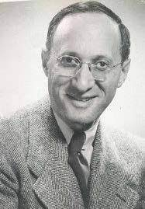
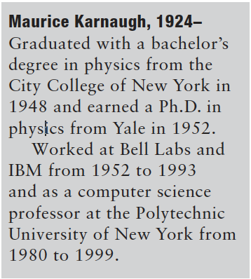
Karnaugh maps
K-maps are a graphical method for simplifying boolean equations
works well for problems with up to four variables
give insight into manipulating boolean equations
invented in 1953 by Maurice Karnaugh, a telecommunications engineer at Bell Labs
Recall that logic minimization involves combining terms
two terms containing an implicant P and the true and complementary forms of some variable A are combined to eliminate A:
PA + PA = P
Karnaugh maps make these combinable terms easy to see by putting them next to each other in a grid
2022

Slide 4
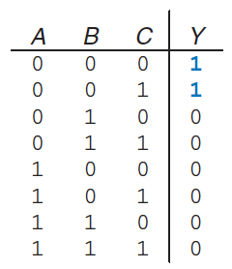
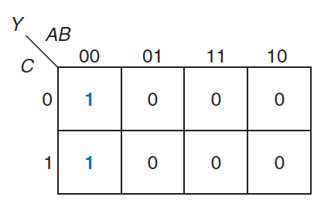
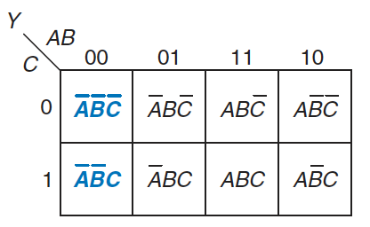
Constructing a Map (1)
Consider the truth table of a three-input function:
The K-map of that table is constructed as:
top row gives the four possible values for A and B
left column gives the two possible values for C
each square corresponds to a row in the truth table and contains the value of the output
a single minterm
For example:
top left square corresponds to the first row in the truth table Y 1 when ABC=000
the minterm is A B C

Slide 5
Constructing a Map (2)
Notice that each square (minterm) differs from an adjacent square by a change in a single variable
adjacent squares share all the same literals except one
which appears in true form in one square and in complementary form in the other
squares representing the minterms A B C and A B C are adjacent and differ only in the variable C
To obtain this property, A and B combinations in the top row are in a peculiar order (Gray code)
00, 01, 11, 10
differs from ordinary binary order (00, 01, 10, 11) in that adjacent entries differ only in a single variable
The K-map also “wraps around”
horizontal wrapping: the first and last columns are considered adjacent
they differ only in one variable (A)
vertical wrapping: the first and last rows are considered adjacent

Slide 6
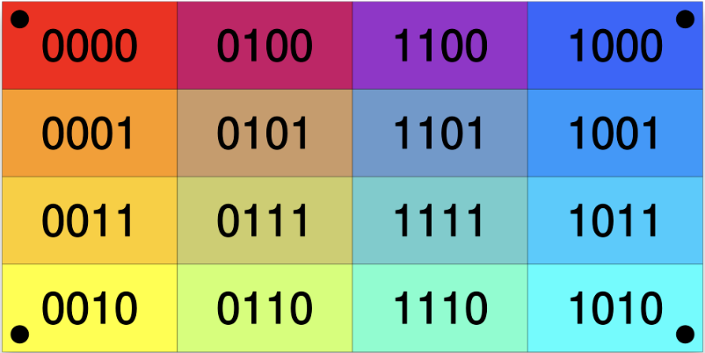
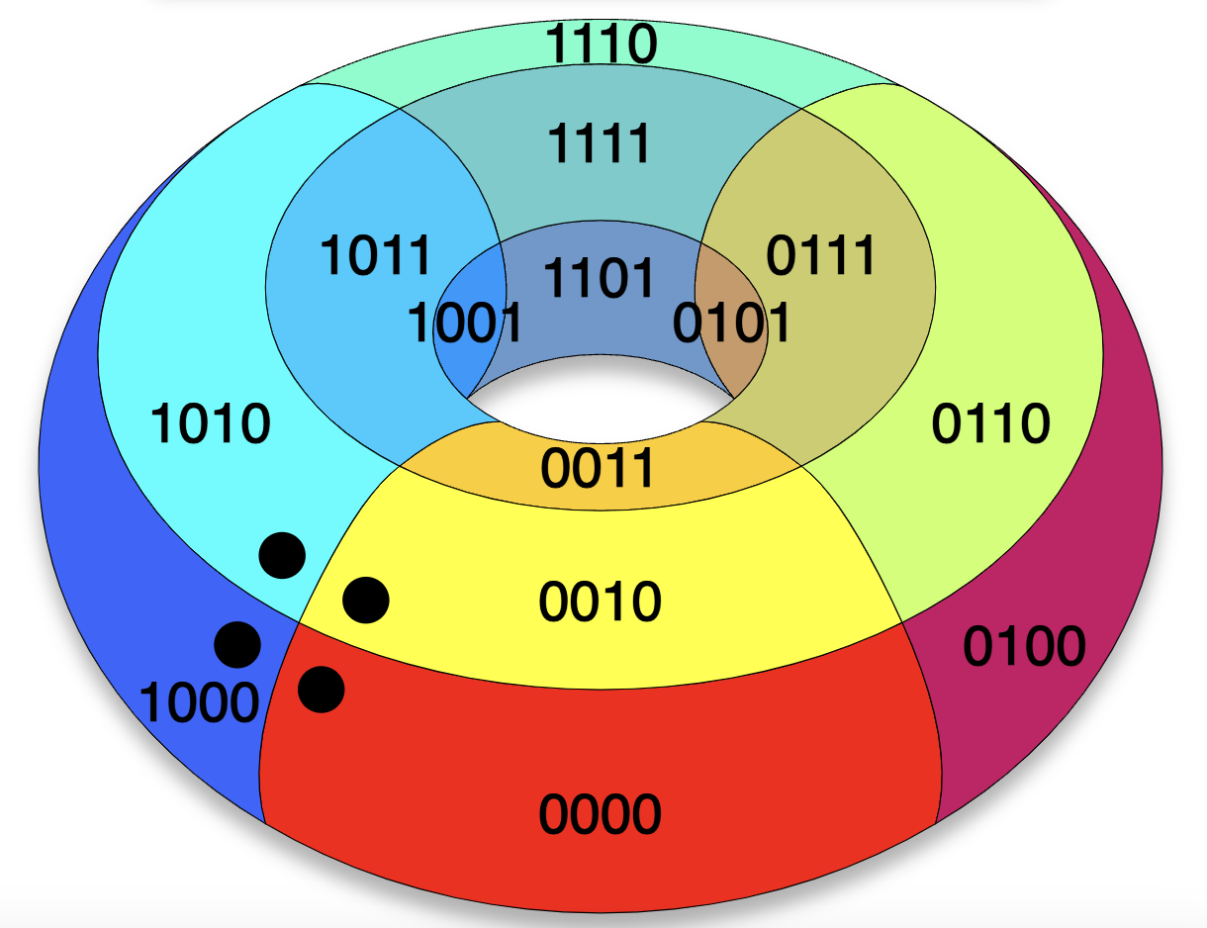
Constructing a Map (3)

Slide 7
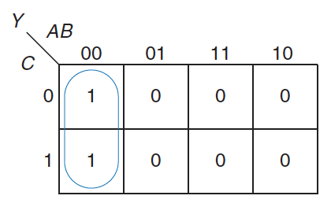
Constructing a Map (4)
We can use boolean algebra to minimize equations in sum-of-products form:
However, K-maps help us do this simplification graphically:
circle all the rectangular blocks of 1 in the map
each circle should be as large as possible
for each circle, write the corresponding implicant
variables whose true and complementary forms are both in the circle are excluded from the implicant
In the example:
C has both its true form and its complementary form (0) in the circle, so we do not include it in the implicant
Y is TRUE when A=B=0, independent of C
The K-map gives the same answer we reached using boolean algebra

Slide 8
Logic Minimization with K-Maps
More formally, recall that a boolean equation is minimized when it is written as a sum of the fewest number of prime implicants
each circle on the K-map represents an implicant
the largest possible circles are prime implicants
Rules for finding a minimized equation from a K-map are as follows:
all the squares in each circle must contain 1
use the fewest circles necessary to cover all the 1
each circle must span a rectangular block that is a power of 2 (i.e. 1, 2, or 4) squares in each direction
each circle should be as large as possible
a circle may wrap around the edges of the K-map
a 1 in a K-map may be circled multiple times if doing so allows fewer circles to be used

Slide 9
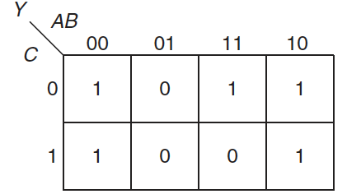
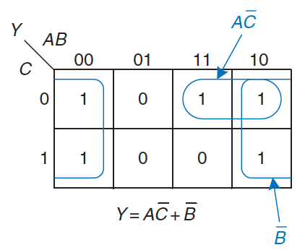
Example of minimization
Suppose we have the function Y = F(A, B, C) with the following K-map:
Minimize the equation:
circle the 1 using as few circles as possible
form the prime implicant by writing those variables that appear in the circle only in true or only in complementary form
Notice
the top-right square is covered twice to make the prime implicant circles as large as possible
the circle covering four squares wraps around the sides of the K-map

Slide 10
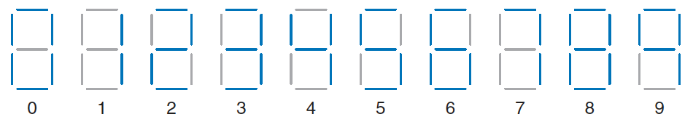
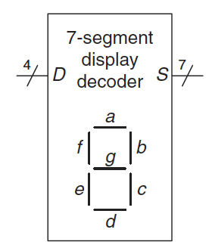
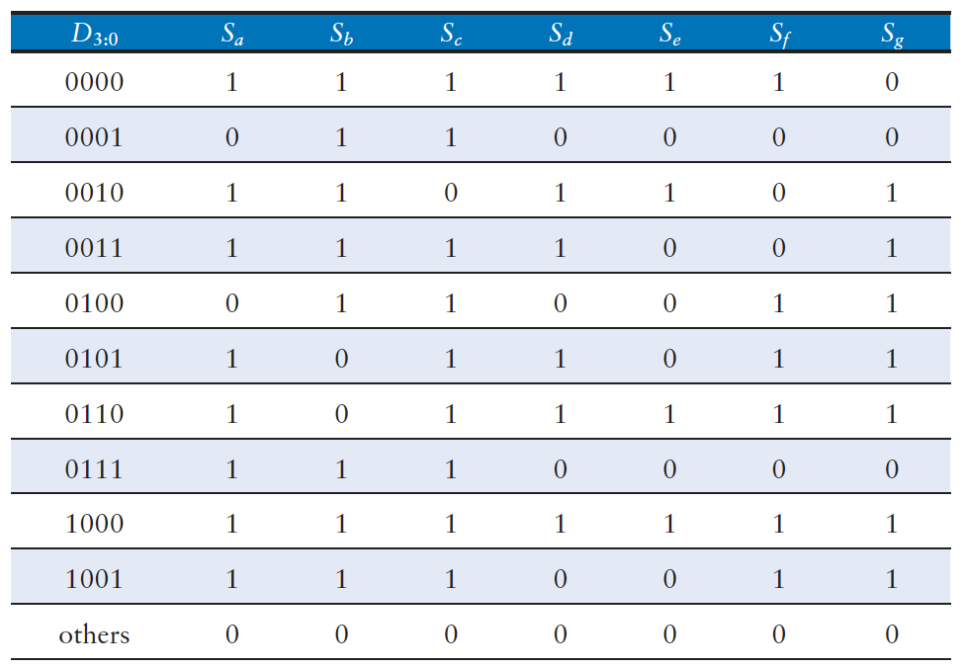
Seven-segment Display Decoder (1)
A device that takes a 4-bit data input D_{3:0} and produces seven outputs S_{a} - S_{g} to control a display from 0 to 9
The truth table is:

Slide 11
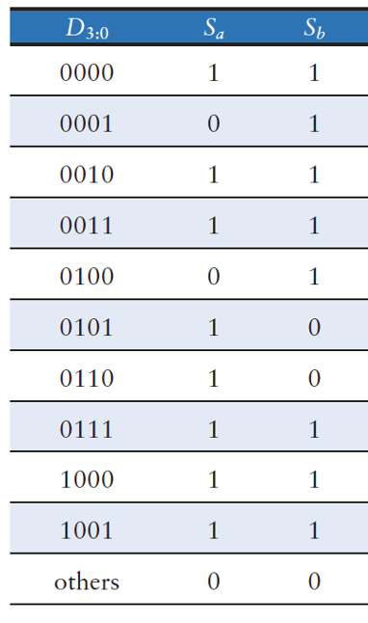
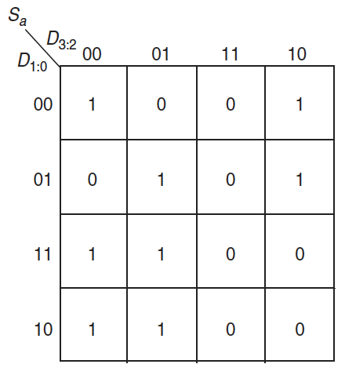
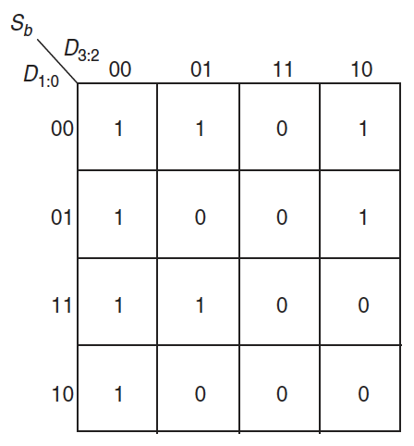
Seven-segment Display Decoder (2)
Each of the seven outputs is an independent function of four variables
As an example, we can draw K-maps for outputs S_{a} and S_{b}
Remember to label rows and columns in Gray code order: 00, 01, 11, 10

Slide 12
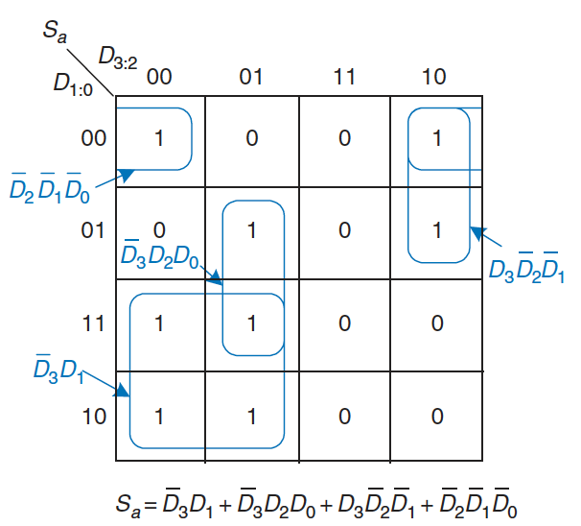
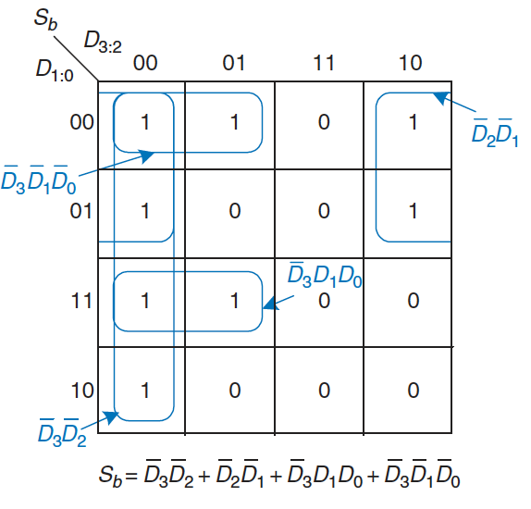
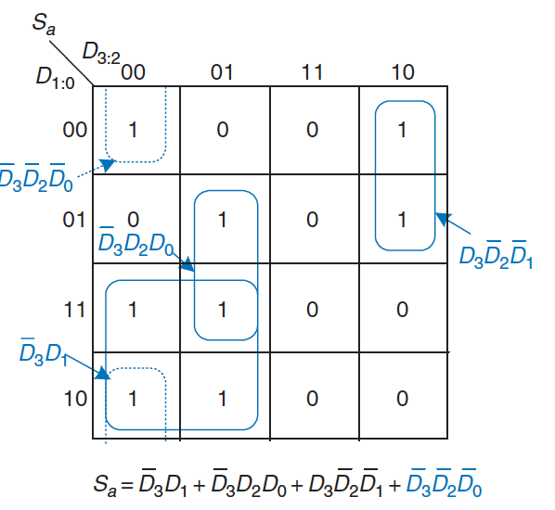
Seven-segment Display Decoder (3)
Circle the prime implicants:
Notice that the minimal set of prime implicants is not unique
For example
0000 entry in the S_{a} K-map was circled along with the 1000 entry to produce the D₂ D₁ D₀ minterm
the circle could have included the 0010 entry instead, producing a D₃ D₂ D₀ minterm

Slide 13
Don’t Cares (1)
Recall that “don’t care” entries for truth table inputs
can reduce the number of rows in the table when some variables do not affect the output
they are indicated by the symbol X, which means that the entry can be either 0 or 1
Don’t cares also appear in truth table outputs where:
the output value is unimportant
or the corresponding input combination can never happen
such outputs can be treated as either 0’s or 1’s at the designer’s discretion
In a K-map, X’s allow for even more logic minimization
they can be circled if they help cover the 1 with fewer or larger circles
but they do not have to be circled if they are not helpful

Slide 14
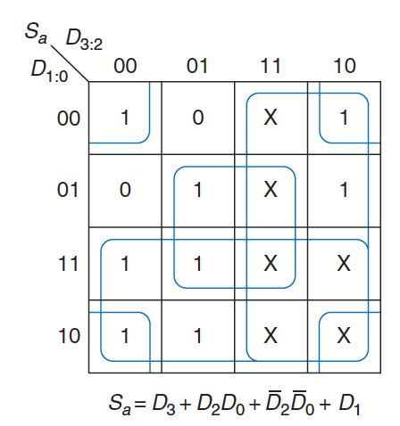
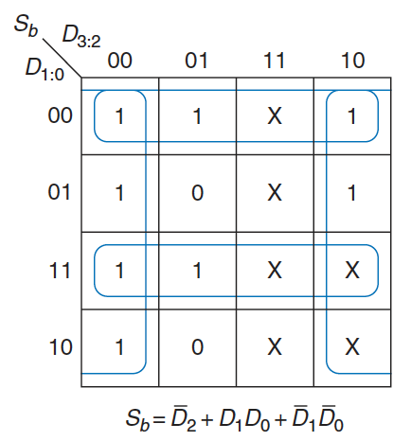
Don’t Cares (2)
We can review the seven-segment display decoder if we don’t care about the output values for illegal input values of 10 to 15
Because don’t cares can be 0 or 1, we circle a don’t care if it allows us to cover the 1 with fewer or bigger circles
Use of don’t cares simplifies the logic substantially

Slide 15
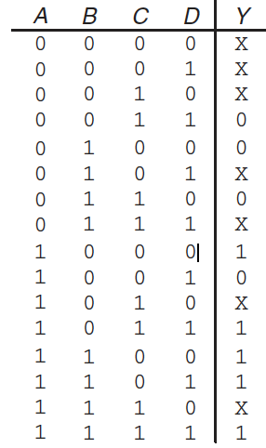
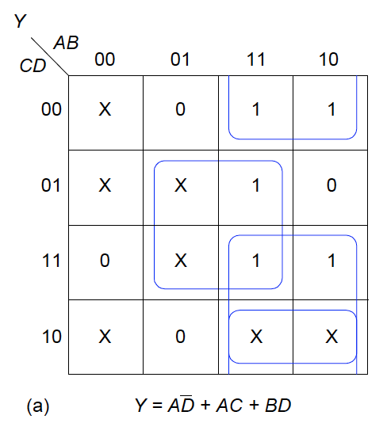
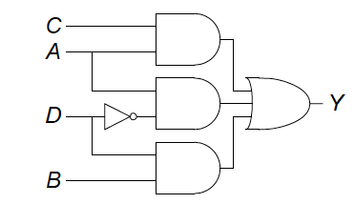
Exercises (1)
Ex5.4: Find a minimal Boolean equation for the following true table and sketch the circuit
Solution:

Slide 16
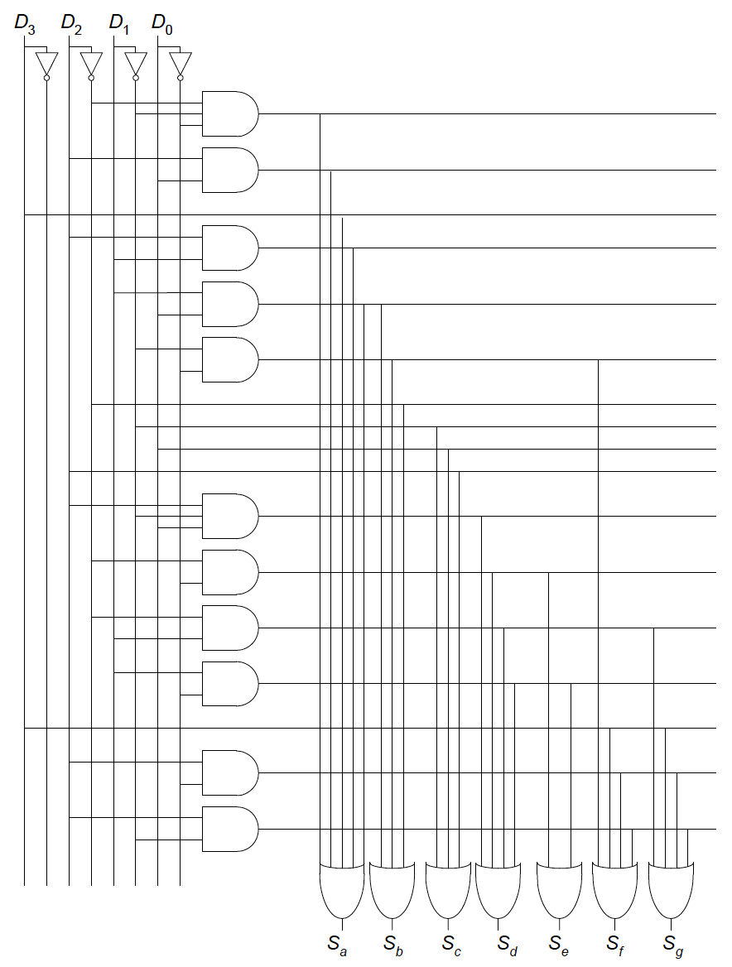
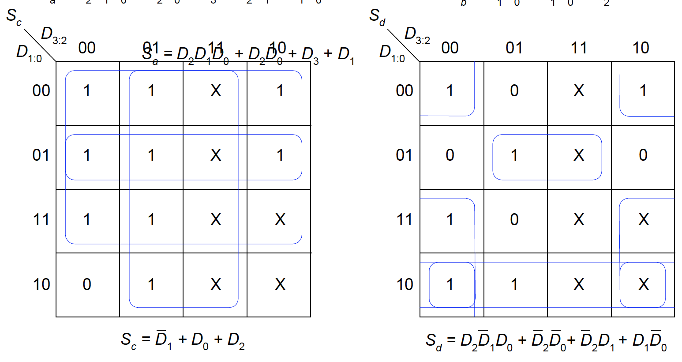
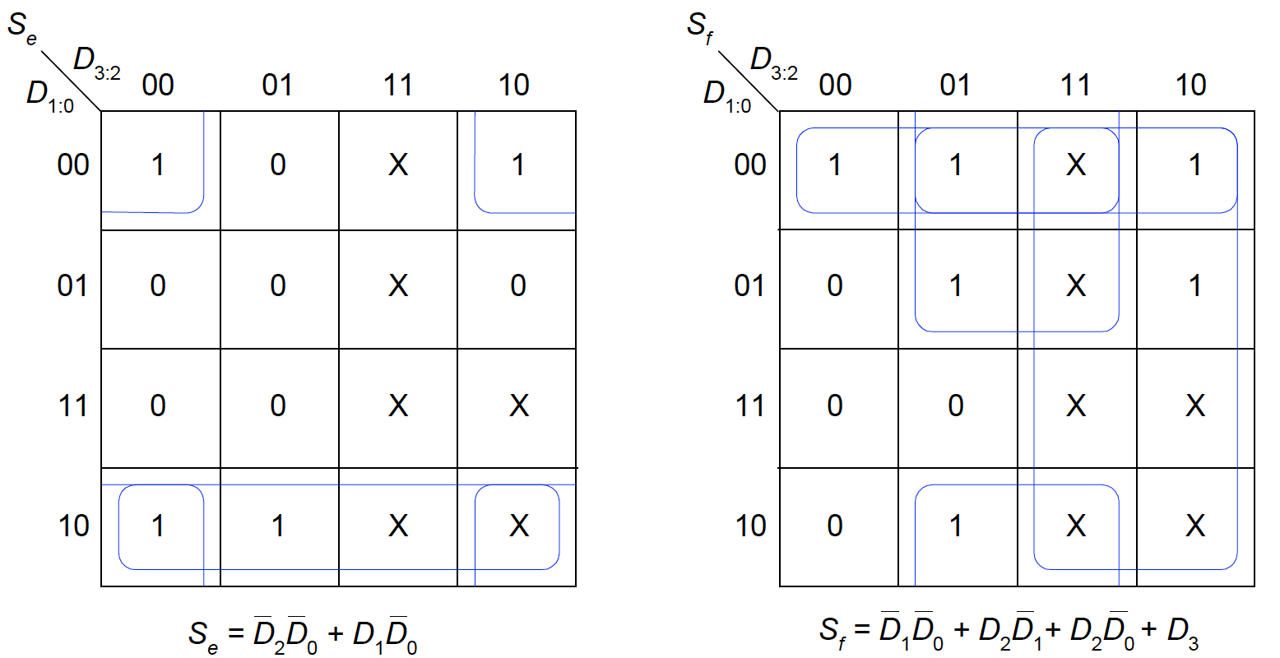
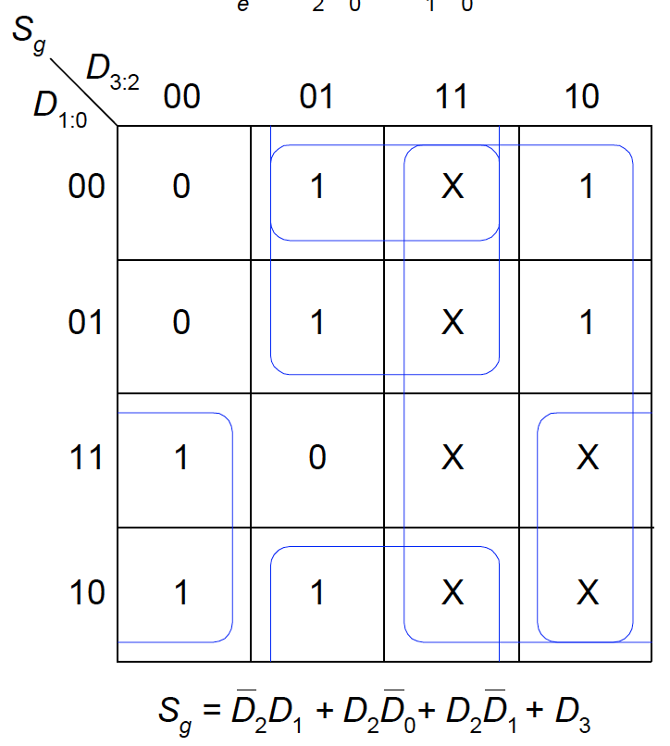
Exercises (2)
Ex5.6: Complete the design of the seven-segment decoder segments S_{c} through S_{g} and sketch a reasonably simple gate-level implementation of part
Solution:

